Slide 1
Data Structure & Algorithms
Trees

Slide 2
Trees
Trees are one of the fundamental data storage structures used in programming.
Why might you want to use a tree?
It combines the advantages of two other structures:
An ordered array and a linked list:
You can search a tree quickly, as you can an ordered array.
you can also insert and delete items quickly, as you can with a linked list.

Slide 3
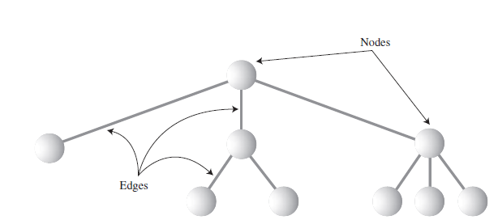
Trees
What Is a Tree?
A tree consists of nodes connected by edges.
the nodes are represented as circles, and the edges as lines connecting the circles.
there is one node in the top row of a tree, with lines connecting to more nodes on the second row, even more on the third, and so on.

Slide 4
In computer programs:
nodes often represent such entities as people, car parts, airline reservations, and so on—in other words,
The typical items we store in any kind of data structure.
The lines (edges) between the nodes:
represent the way the nodes are related.
It’s easy (and fast) for a program to get from one node to another if there is a line connecting them.
Edges are likely to be represented in a program by references
There are different kinds of trees, we’ll be discussing a specialized form of tree called a binary tree.

Slide 5
Tree Terminology
Path:
Think of someone walking from node to node along the edges that connect them. The resulting sequence of nodes is called a path.
Root:
The node at the top of the tree is called the root. There is only one root in a tree.
Parent:
Any node (except the root) has exactly one edge running upward to another node. The node above it is called the parent of the node.
Child:
Any node may have one or more lines running downward to other nodes. These nodes below a given node are called its children.
Leaf:
A node that has no children is called a leaf node or simply a leaf. There can be only one root in a tree, but there can be many leaves.

Slide 6
Tree Terminology (Cont’d)
Subtree:
Any node may be considered to be the root of a subtree, which consists of its children, and its children’s children, and so on.
Visiting:
A node is visited when program control arrives at the node, usually for the purpose of carrying out some operation on the node, such as checking the value of one of its data fields or displaying it.
Traversing:
To traverse a tree means to visit all the nodes in some specified order. For example, you might visit all the nodes in order of ascending key value.
Levels:
The level of a particular node refers to how many generations the node is from the root.
Keys:
In tree diagrams, when a circle represents a node holding a data item, the key value of the item is typically shown in the circle.. This value is used to search for the item or perform other operations on it.

Slide 7
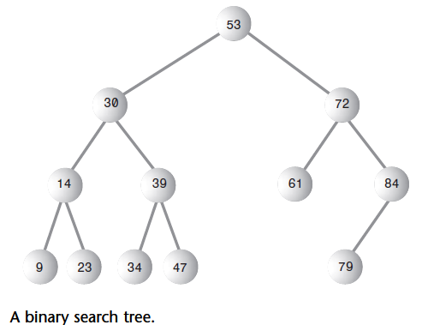
Binary Trees
Each node in a binary tree has a maximum of two children.
The two children of each node in a binary tree are called the left child and the right child.
A node in a binary tree doesn’t necessarily have the maximum of two children; it may have:
Only a left child, or
Only a right child, or
It can have no children at all
(in which case it’s a leaf).

Slide 8
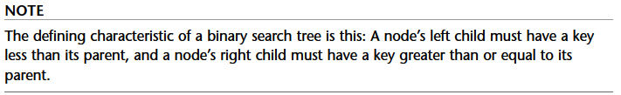
Binary Trees (Cont’d)
The kind of binary tree we’ll be dealing with is technically called a binary search tree.

Slide 9
How Do Binary Search Trees Work?
Common binary tree operations is:
Finding A Node With A Given Key,
Inserting A New Node,
Traversing The Tree, And
Deleting a node

Slide 10
The Node Class
First, we need a class of node objects. These objects contain the data representing the objects being stored and also references to each of the node’s two children.
class Node
{
int iData; // data used as key value
double fData; // other data
node leftChild; // this node’s left child
node rightChild; // this node’s right child
}

Slide 11
The Tree Class
class Tree
{
private Node root; // the only data field in Tree
public void find(int key)
{
}
public void insert(int id, double dd)
{
}
public void delete(int id)
{
}
// various other methods
} // end class Tree

Slide 12
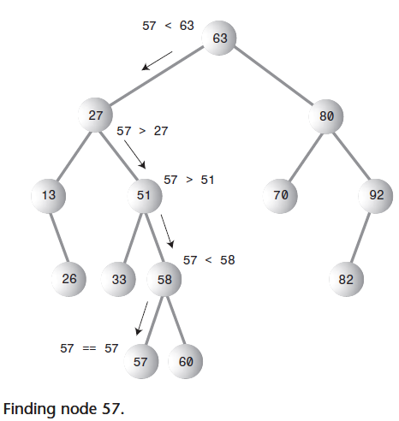
Finding a Node

Slide 13
Finding a Node code
public Node find(int key) // find node with given key
{
Node current = root; // start at root
while(current.iData != key) // while no match,
{
if(key < current.iData) // go left?
current = current.leftChild;
else
current = current.rightChild; // or go right?
if(current == null) // if no child,
return null; // didn’t find it
}
return current; // found it
}

Slide 14
Inserting a Node
To insert a node:
we must first find the place to insert it.
We follow the path from the root to the appropriate node, which will be the parent of the new node.
When this parent is found, the new node is connected as its left or right child, depending on whether the new node’s key is less or greater than that of the parent.

Slide 15
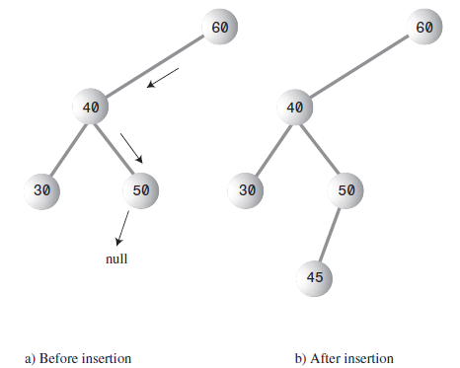
Inserting a Node Code:
public void insert(int id, double dd)
{ Node newNode = new Node();
newNode.iData = id; // insert data
newNode.dData = dd;
if(root==null) // no node in root
root = newNode;
else // root occupied
{ Node current = root; // start at root
Node parent;
while(true) // (exits internally){
parent = current;
if(id < current.iData) // go left?
{current = current.leftChild;
if(current == null) // if end of the line,
{ // insert on left
parent.leftChild = newNode;
return;} } // end if go left
else // or go right?
{current = current.rightChild;
if(current == null) // if end of the line
{parent.rightChild = newNode;
return;
}}} }} // end insert()

Slide 16
Traversing the Tree
Traversing a tree means visiting each node in a specified order.
There are three simple ways to traverse a tree. They’re called preorder, inorder, and postorder.
The order most commonly used for binary search trees is inorder,

Slide 17
Inorder Traversal
An inorder traversal of a binary search tree will cause all the nodes to be visited in ascending order, based on their key values.
The simplest way to carry out a traversal is the use of recursion.
The method needs to do only three things:
1. Call itself to traverse the node’s left subtree.
2. Visit the node.
3. Call itself to traverse the node’s right subtree.

Slide 18
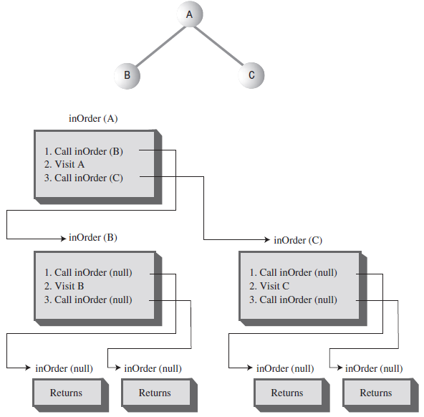
Inorder Traversal Code
private void inOrder(node localRoot)
{
if(localRoot != null)
{
inOrder(localRoot.leftChild);
System.out.print(localRoot.iData + “ “);
inOrder(localRoot.rightChild);
}
}

Slide 19
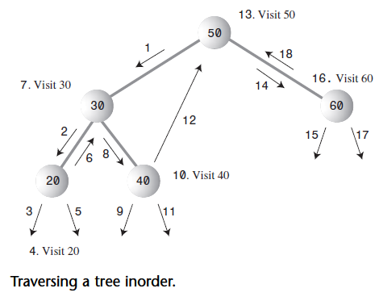
Inorder Traversal (Cont’d)

Slide 20
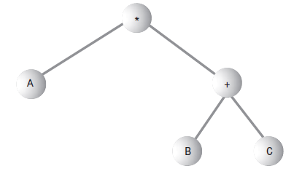
Preorder and Postorder Traversals
These traversals are indeed useful if you’re writing programs that parse or analyze algebraic expressions.
A binary tree (not a binary search tree) can be used to represent an algebraic expression that involves the binary arithmetic operators +, –, /, and *.
The root node holds an operator, and the other nodes hold either a variable name (like A, B, or C), or another operator.
Each subtree is a valid algebraic expression.
Example: A*(B+C)

Slide 21
Preorder traversal
Here’s the sequence for a preorder() method:
1. Visit the node.
2. Call itself to traverse the node’s left subtree.
3. Call itself to traverse the node’s right subtree.

Slide 22
Preorder traversal (Cont’d)
Traversing this tree using preorder would generate the expression:
*A+BC
This is called prefix notation

Slide 23
Postorder traversal
The third kind of traversal, postorder, contains the three steps arranged in yet another way:
1. Call itself to traverse the node’s left subtree.
2. Call itself to traverse the node’s right subtree.
3. Visit the node.

Slide 24
Postorder traversal (Cont’d)
For this tree, visiting the nodes with a postorder traversal would generate the expression
ABC+*
This is called postfix notation

Slide 25
Finding Maximum and Minimum Values
easy it is to find the maximum and minimum values in a binary search tree.(why?)
For the minimum, go to the left child of the root; then go to the left child of that child, and so on, until you come to a node that has no left child. This node is the minimum.
public Node minimum() // returns node with minimum key value
{
Node current, last;
current = root; // start at root
while(current != null) // until the bottom,
{
last = current; // remember node
current = current.leftChild; // go to left child
}
return last;
}

Slide 26
Finding Maximum and Minimum Values
For the maximum value in the tree, follow the same procedure, but go from right child to right child until you find a node with no right child. This node is the maximum.

Slide 27
Deleting a Node
We start by finding the node you want to delete, as in find() and insert().
When you’ve found the node, there are three cases to consider:
1. The node to be deleted is a leaf (has no children).
2. The node to be deleted has one child.
3. The node to be deleted has two children.

Slide 28
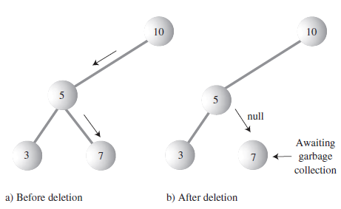
Case 1: The Node to Be Deleted Has No Children
To delete a leaf node, you simply change the appropriate child field in the node’s parent to point to null, instead of to the node.

Slide 29
public boolean delete(int key) // delete node with given key
{ // (assumes non-empty list)
Node current = root;
Node parent = root;
boolean isLeftChild = true;
while(current.iData != key) // search for node
{ parent = current;
if(key < current.iData) // go left?
{ isLeftChild = true;
current = current.leftChild;}
else // or go right?
{
isLeftChild = false;
current = current.rightChild;
}
if(current == null) // end of the line,
return false; // didn’t find it
} // end while…// found node to delete

Slide 30
if(current.leftChild==null &&
current.rightChild==null)
{
if(current == root) // if root,
root = null; // tree is empty
else if(isLeftChild)
parent.leftChild = null; // disconnect
else // from parent
parent.rightChild = null;
}

Slide 31
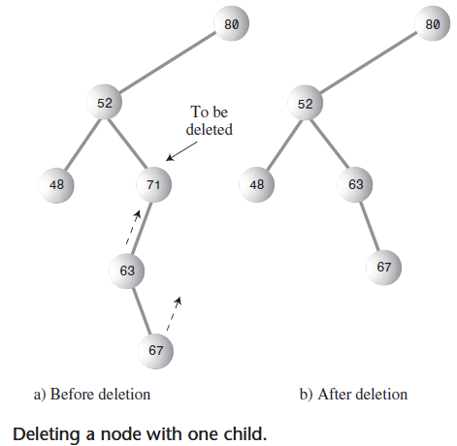
Case 2: The Node to Be Deleted Has One Child
The node has only two connections: to its parent and to its only child.
When deleting the node, we have to connect its parent directly to its child.

Slide 32
// delete() continued...
// if no right child, replace with left subtree
else if(current.rightChild==null)
if(current == root)
root = current.leftChild;
else if(isLeftChild) // left child of parent
parent.leftChild = current.leftChild;
else // right child of parent
parent.rightChild = current.leftChild;
// if no left child, replace with right subtree
else if(current.leftChild==null)
if(current == root)
root = current.rightChild;
else if(isLeftChild) // left child of parent
parent.leftChild = current.rightChild;
else // right child of parent
parent.rightChild = current.rightChild;
// continued...

Slide 33
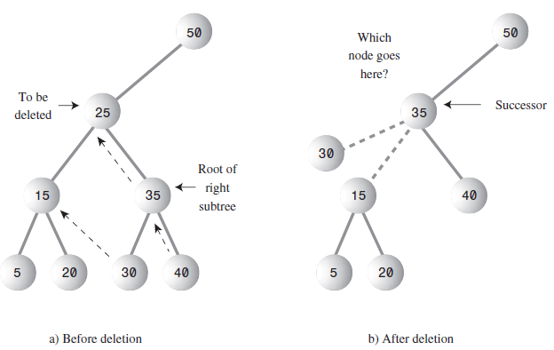
Case 3: The Node to Be Deleted Has Two Children
If the deleted node has two children, you can’t just replace it with one of these children, at least if the child has its own children.

Slide 34
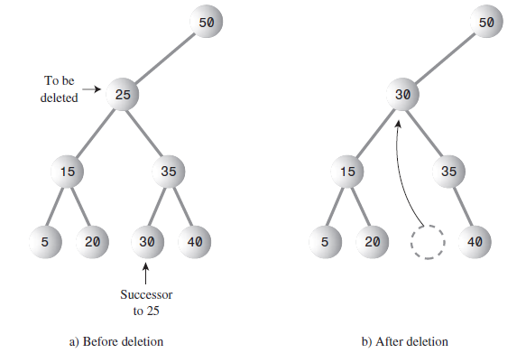
Delete Node with Two Children (Cont’d)
Remember that in a binary search tree the nodes are arranged in order of ascending keys.
For each node, the node with the next-highest key is called its inorder successor, or simply its successor.
To delete a node with two children, replace the node with its inorder successor.

Slide 35
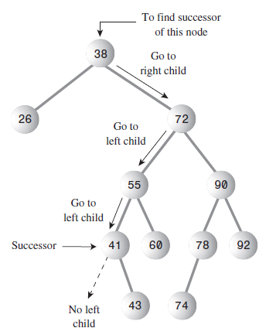
Finding the Successor
First, the program goes to the original node’s right child, which must have a key larger than the node.
Then it goes to this right child’s left child (if it has one), and
To this left child’s left child, and so on, following down the path of left children.
The last left child in this path is the successor of the original node

Slide 36
Finding the Successor (code)
// returns node with next-highest value after delNode
// goes to right child, then right child’s left descendants
private node getSuccessor(node delNode)
{
Node successorParent = delNode;
Node successor = delNode;
Node current = delNode.rightChild; // go to right child
while(current != null) // until no more
{ // left children,
successorParent = successor;
successor = current;
current = current.leftChild; // go to left child
}
// if successor not
if(successor != delNode.rightChild) // right child,
{ // make connections
successorParent.leftChild = successor.rightChild;
successor.rightChild = delNode.rightChild;
}
return successor;
}

Slide 37
Successor Is Right Child of delNode
Successor Is Right Child of delNode:
If successor is the right child of current, This operation requires only two steps:
1. Unplug current from the rightChild field of its parent (or leftChild field if appropriate), and set this field to point to successor.
2. Unplug current’s left child from current, and plug it into the leftChild field of successor.
Here are the code statements that carry out these steps, excerpted from delete():
1. parent.rightChild = successor;
2. successor.leftChild = current.leftChild;

Slide 38
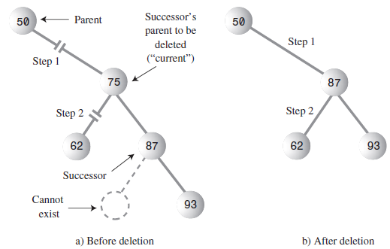
Successor Is Right Child of delNode (Cont’d)

Slide 39
Successor Is Right Child of delNode (Cont’d)
Step 1: If the node to be deleted, current, is the root, it has no parent so we merely set the root to the successor. Otherwise, the node to be deleted can be either a left or right child so we set the appropriate field in its parent to point to successor. When delete() returns and current goes out of scope, the node referred to by current will have no references to it, so it will be discarded during Java’s next garbage collection.
Step 2: We set the left child of successor to point to current’s left child.

Slide 40
Successor Is Left Descendant of Right Child of delNode
If successor is a left descendant of the right child of the node to be deleted, four steps are required to perform the deletion:
1. Plug the right child of successor into the leftChild field of the successor’s parent.
2. Plug the right child of the node to be deleted into the rightChild field of successor.
3. Unplug current from the rightChild field of its parent, and set this field to point to successor.
4. Unplug current’s left child from current, and plug it into the leftChild field of successor.

Slide 41
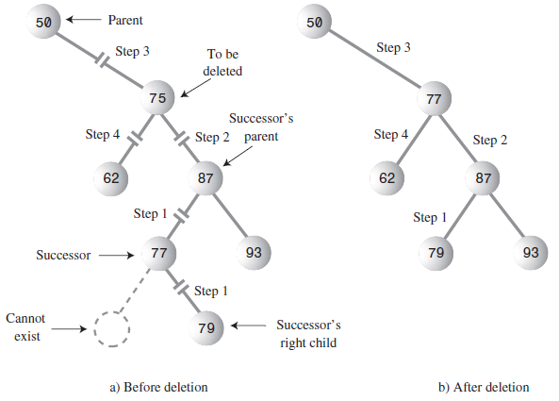

Slide 42
Here’s the code for these four steps:
1. successorParent.leftChild = successor.rightChild;
2. successor.rightChild = delNode.rightChild;
3. parent.rightChild = successor;
4. successor.leftChild = current.leftChild;

